Slide 1
Quality planetX: a markerless augmented reality app
Prepared by:
(Aria: Survey and Report Generation System Team)
Brugada, Jesus P.
Gloria, Diego P.
Roguel, Jairus G.
Ruiz, Angel S.

Slide 2
Introduction
PlanetX: Markerless Augmented Reality App is an application that will help the clients of SMX Convention Center to visualize the events they want to organize with the help of a smartphone camera

Slide 3
System Objectives
To detect the ground plane of SMX Convention Center
To detect the camera of the smartphone
To place some visual objects on the ground plane

Slide 4
Purpose
Identify the features of the app that needs to be tested
To gauge the performance of the system
To list recommendations for the improvement of the system
To show the result of the test activities
To ensure that the functionalities and design of the app are implemented and in the demand of the client

Slide 5
Scope
The test plan is only for PlanetX: Markerless Augmented Reality App development team
Use cases utilized in the testing came from Testlink

Slide 6
References
The knowledge of the Team Members on their project
Mock-ups
Use Cases
Final Paper of the System

Slide 7
Test Area and Specification
UC No, | UC Name | Test Type | Build No.
UC01 | Download the PlanetX from the App Store | Functional, Performance | 001, 002
UC02 | Tap the PlanetX application | Functional, GUI, Performance | 001, 002
UC03 | Choose number of people to accommodate | Functional, GUI, Performance | 001
UC03.1 | Detect ground plane | Functional, GUI, Performance | 002
UC04 | Choose event | Functional, GUI, Performance | 001
UC04.1 | Choose 3D objects | Functional, GUI, Performance | 002

Slide 8
UC No. | UC Name | Test Type | Build No.
UC05 | Interact with the AR Camera | Functional, GUI, Performance | 001
UC05.1 | Resize 3D objects | Functional, GUI, Performance | 002
UC06 | Close the app | Functional, GUI, Performance | 001,002

Slide 9
Milestone
Deliverables | Date Start | Date End
Create Use Cases | February 27, 2017 | March 6, 2017
Develop Test Plan | February 27, 2017 | March 6, 2017
Update Test Plan | March 6, 2017 | March 13, 2017
BUILD 001
Test Case | March 13, 2017 | March 13, 2017
Execute TC – Build 001 | March 16, 2017 | March 16, 2017
Test Log/Reports | March 16, 2017 | March 20, 2017
Review/Update Cases | March 20, 2017 | March 27, 2017
BUILD 002
Execute TC – Build 002 | March 27, 2017 | March 30, 2017
Test Log/Results | March 30, 2017 | March 30, 2017

Slide 10
Participants
Name | Role
Angel Ruiz | Project Manager
Jairus Roguel | Software Designer
Jesus Brugada | Quality Assurance Manager
Diego Gloria | Quality Assurance Analyst

Slide 11
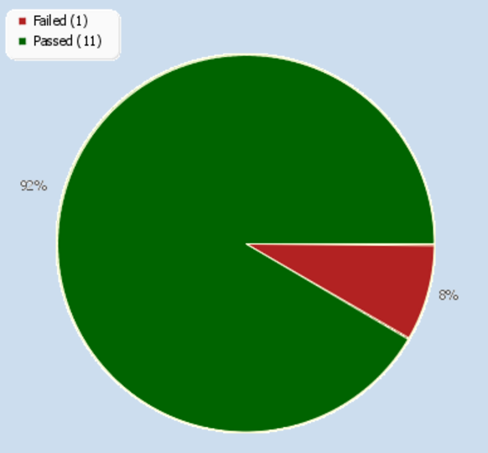
Pie Chart of Iteration 1 and 2 consisting of 12 Test Cases

Slide 12
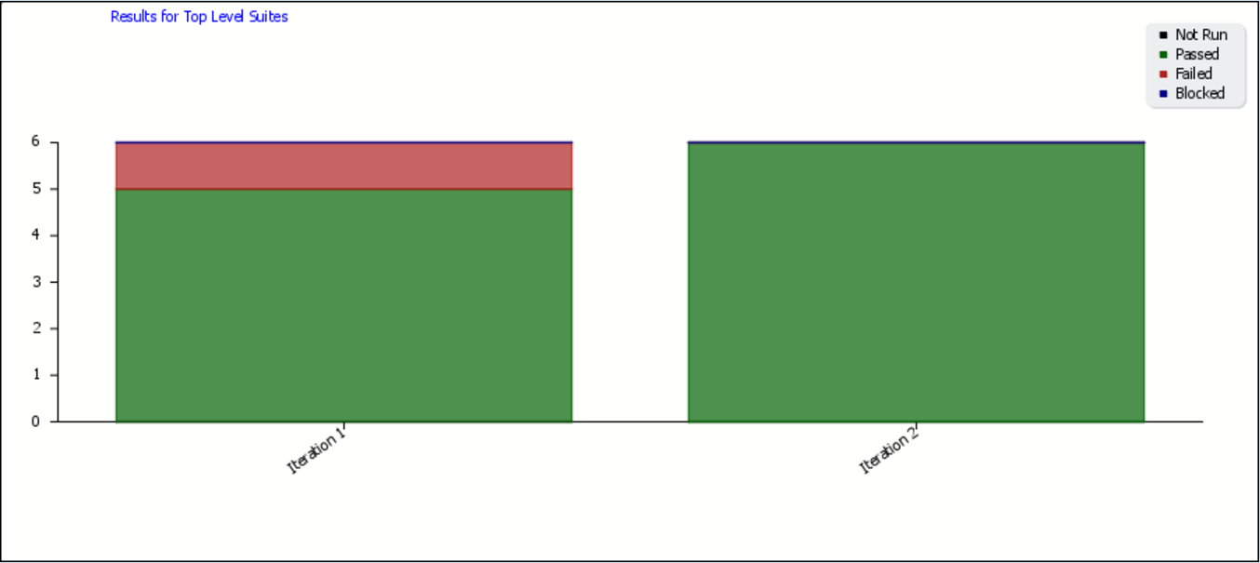
Test Result Per Test Case

Slide 13
Overall Build Status per Iteration

Slide 14
Summary of Test Result
Passed Result – 11/12 Test Cases
Failed Result – 1/12 Test Cases
Blocked Result – 0/12 Test Cases
Not Run Result – 0/12 Test Cases

Slide 15
Environmental Needs Hardware and Software
Resource | Installed OS/Software
Testing Computer | Windows 10 64-bit Google Chrome Web Browser Testlink Website
Productivity and Support Tools
Tool’s Purpose | Tool Name | Vendor or in-house | Version
Bug Tracking Management | Testlink | Open Source | 1.9.2
Test Management | Testlink | Open Source | 1.9.2
Documentation | MS Word, MS Powerpoint | Microsoft | 2016
Revision Control System | Github | Open Source | 2.12.2

Slide 16
Planning Risks and Contingencies
Risk | Mitigation | Contingency
When there is shortage in test time | Make the most out the test schedule by efficiently testing use cases | Have more people engaged on testing
The test didn’t reflect the use cases | Study the system and the possibility of it going the wrong way | Revise either the use cases or the system
Not enough number of use cases | Do a walkthrough of the app and list every functionality | Revise the use cases and do a quick walkthrough
Requests for additional updates and features | List every possible added features in the scope for future preference | Make sure that the build is within the scope of the project, or else it should not be changed

Slide 17
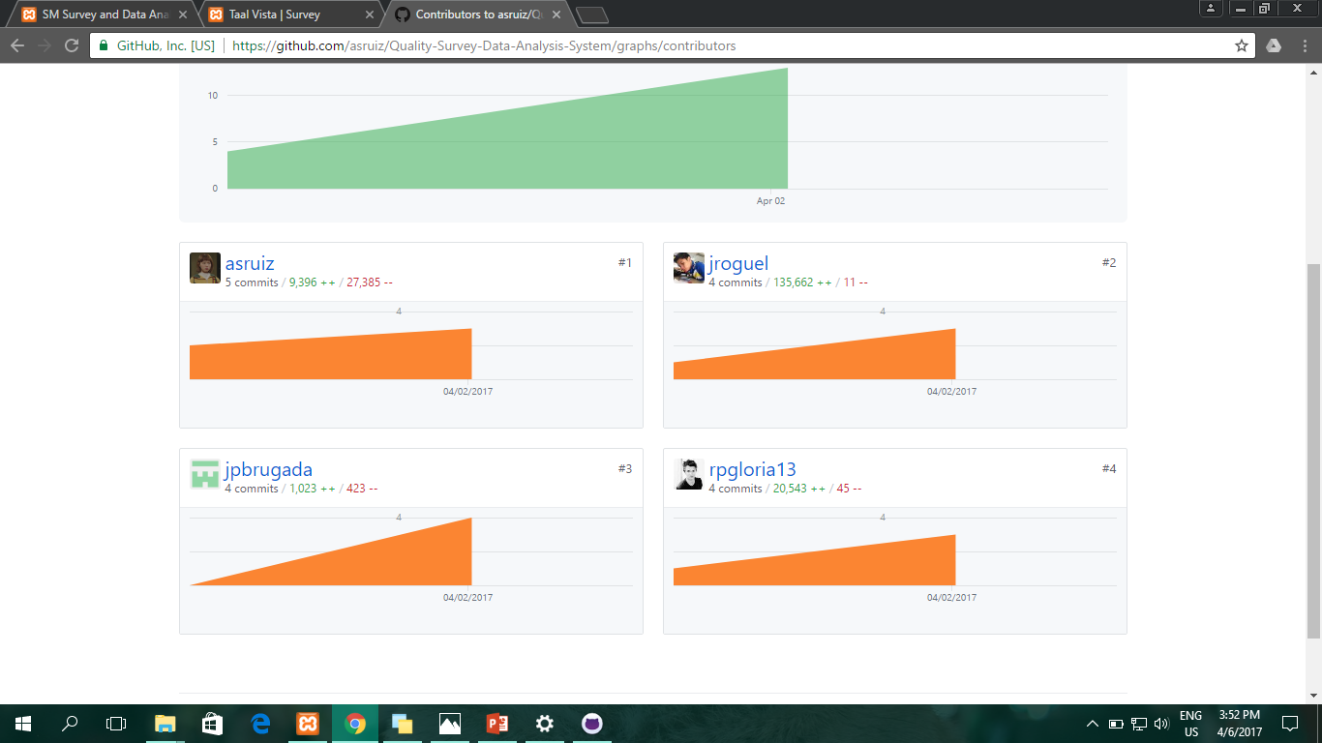
Github Commits

